Slide 1


Prediction of Flight Delay
Jean Louis Jonilyto

Slide 2
Table of contents :
Introduction
Data
Data Preprocessing
Methodology
EDA
Modeling
5. Conclusion

Slide 3
Project Description
Air traffic, let's say, air transport has had a truly gigantic effect on the world. It is one of the main drivers of globalization. The commercialization of air transport has made the world a smaller, more connected place. People can easily visit, explore everywhere, every corner, even the remotest corners of the earth, allowing us to connect with cultures far removed from our own. Businesses can grow and connect with each other, and goods can be shipped around the world in a matter of hours, travel around the world has become faster with air travel.
However, in spite of all the beauty of this means of transport and all its comfort, all is not rosy for the airlines, certainly, air traffic generates big profits, and yet, some problems come to hinder them, such as: airplane accidents, breakdowns or flight delays, etc... Let's look at flight delays, because that's what my study will be based on. What is flight delay? A flight delay is when a plane should leave or arrive at a scheduled time, yet it's delayed or landed later than planned.

Slide 4
A company, which constantly has delays in its flights either on departure or arrival, could lose its customers or contracts, because a customer who is not satisfied with its services is almost lost, the loss of customers results in a decrease in revenue. The primary objective of a company is to maximize its profits while satisfying the needs of its customers, a need to move and arrive on time without any problem.
This project, I have carried out primarily for airlines who wish to optimize their delays in order to better manage their services, with the goal of increasing the confidence and loyalty of their customers. Secondly, this project affects travellers who want to know the best time according to their requirements to travel without expecting too many flight delays.
In my work, I will try to, over a period of about three years :
*1) Look at the number of flights made through Haiti that will be divided into delays and non_delays while grouping them by :
* A) Company
* B) Time
* C) Day
* D) Month
* E) Quarter
2) With the Learning Machine to predict flight delays,verification of the accuracy of the prediction as well as the ROC curve

Slide 5
Data
The data used for the realization of this project can be found at the following address https://www.flightera.net/fr/airport/Port-au-Prince/MTPP/arrival.
and the way to get them is in this notebook.
https://github.com/Shito3/Airplanes_Analysis/tree/master/Results

Slide 6
Data Preprocessing
First of all we did a scrapping and saved the results in CSV format.
At the first glance on the dataset, we can see that there are some columns that are not removable. With a df = df.drop(), the magic is done, they are not there anymore. Second task, check if there are no null values, the df[df[''].isna()] and df.isnull().sum() will identify them all and add them together to remove them df.dropna(inplace = True) .
Below we will see that there are Google ADS present in our dataset, to remove them, just look at the common pattern that is window, with the code df2 = df[~df[''].str.contains('window.')], they are all gone.

Slide 7
Data Preprocessing
Still in data preprocessing. In order to separate the flight dates and the status of the flights, we will create functions to do so, the columns that are not important to our study must be deleted.
Once again, to better manipulate the date, we will create a new function to convert it. Then after new functions have been created to convert the time to minutes, one to tell if there is a delay or not. A cols variable is created for the features.
And voila, now our dataset is really ready to do EDA and Modeling.

Slide 8
EDA
The methodology in this project consists of two parts:
-Exploratory Data Analysis: Consists of visualizing air traffic per day
- Modeling: With the Learning Machine to predict flight delays

Slide 9
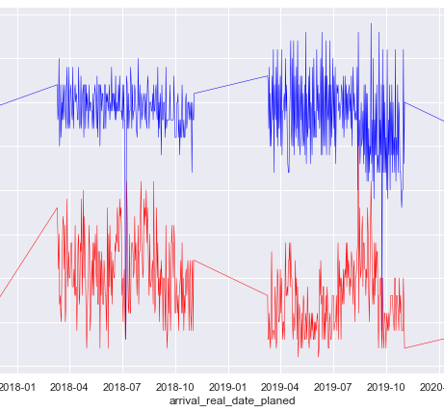
EDA
As the graph shows, we can see that from October 2017 to April 2018, the number of delays and the number of flights have the same trend, they are increasing.
During the same period for the years 2018-2019, delays are inversely proportional to the number of flights, as long as the number of flights decreases the amount of delay increases and for the period 2019-2020 it is always proportional, the number of flights increases and decreases.

Slide 10
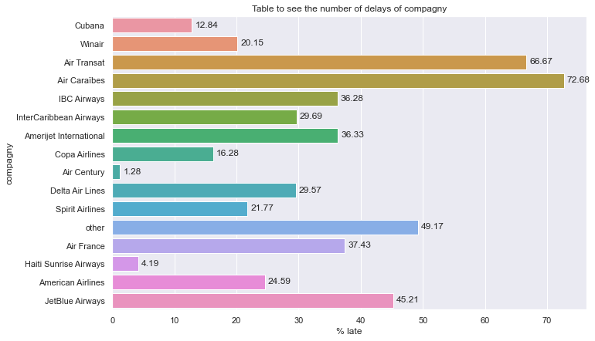
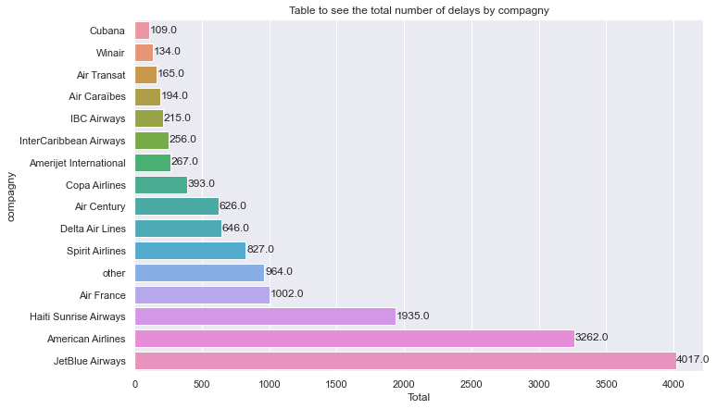
EDA
We can notice that the majority of airlines that make fewer flights are more likely to produce delays, even if JetBlue Airway, despite these many flights, remains the leader in terms of flights and delays.

Slide 11
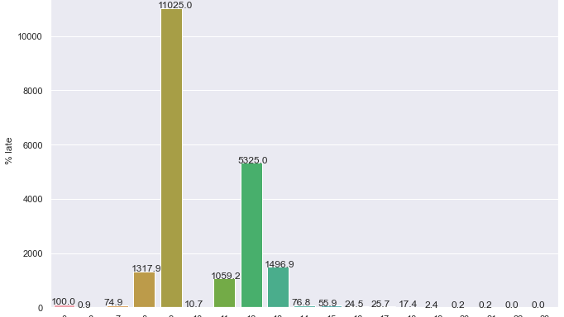
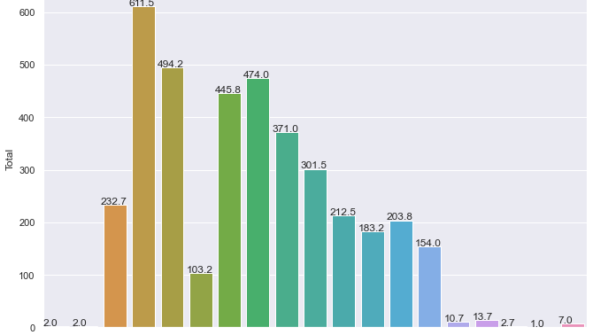
EDA
A lot of flights are made around eight o'clock, nine o'clock, and eleven o'clock to fourteen o'clock, but around nine o'clock and twelve o'clock there are a lot of delays.

Slide 12
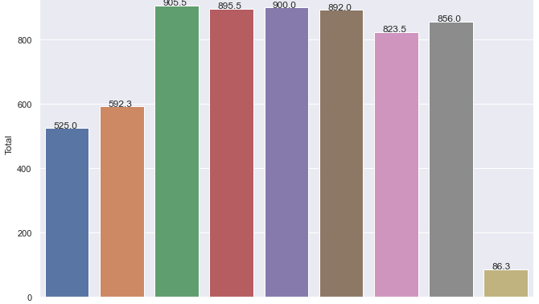
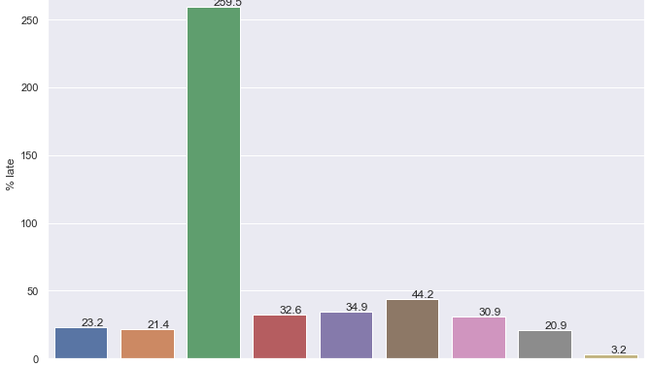
EDA
During the months of June, July, August, September, October and November, the majority of flights are made, June and August in particular, in May, the greatest number of delays are there.

Slide 13
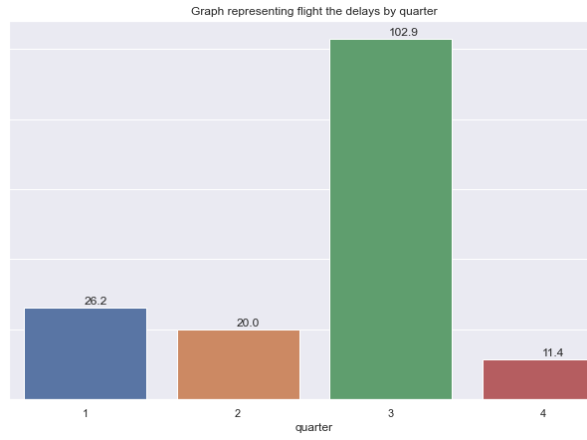
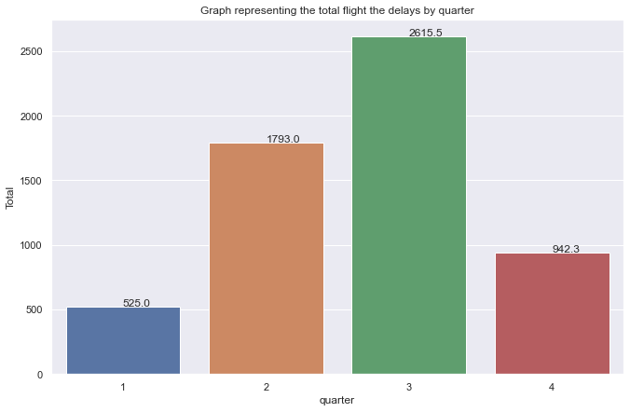
EDA
The third and second trimester are the two trismetres where there is a great peak of flight, in theme of delay, the third trimester is in function of delay is crowned champion, it surpasses all the others.

Slide 14
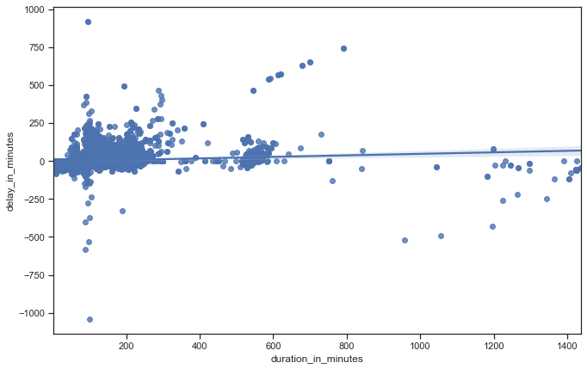
EDA
As the graph shows, the longer the flight lasts the more it tends to increase the delay.

Slide 15
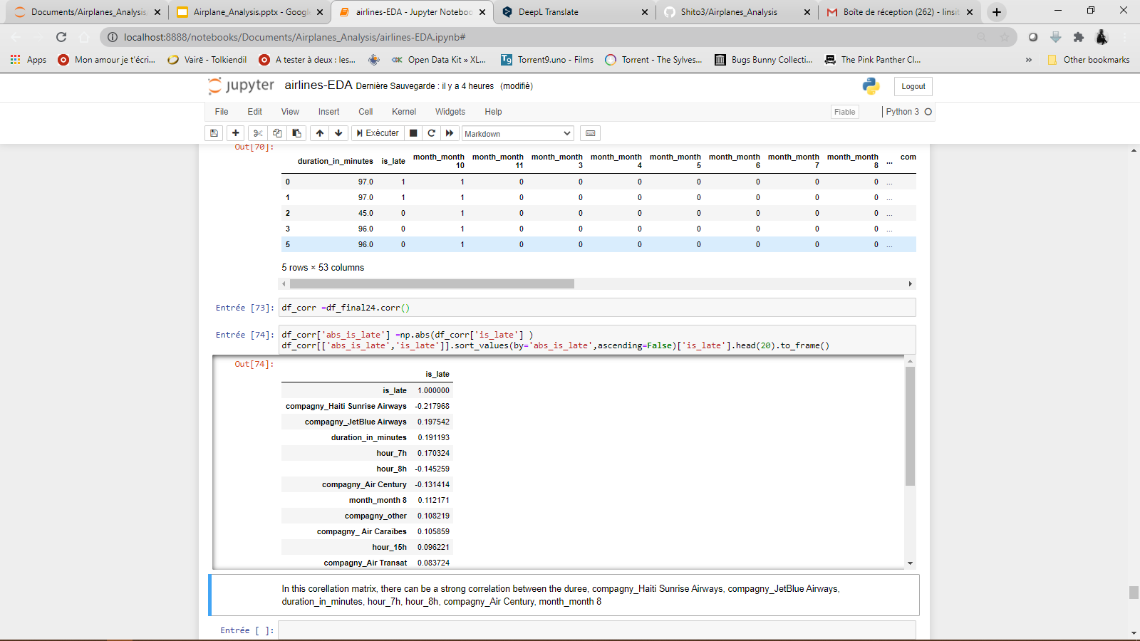
EDA

Slide 16
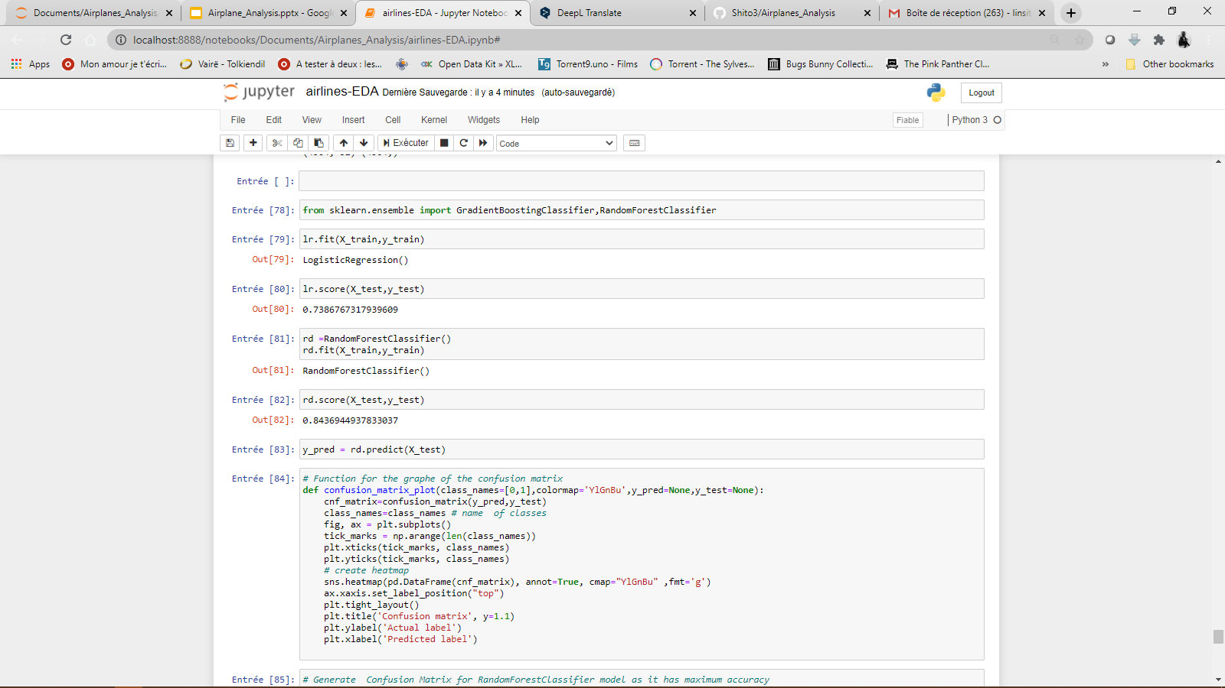
EDA
For our prediction RandomForestClassifier gives the best accuracy, with a total accuracy of 84.36944937833037%.

Slide 17
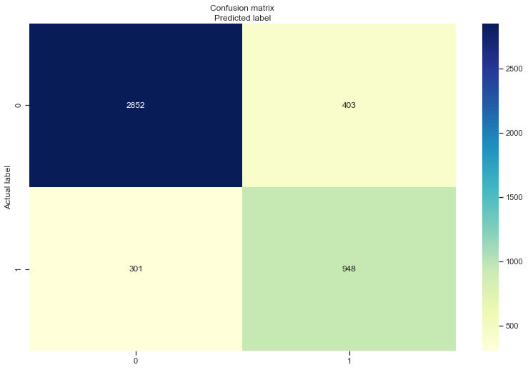
MODELING
In the confusion we can see that our prediction was right 2852 times predicting that there will be flight delays and it was wrong 403, for the predictions of no delay it is 301 times bad predictions against 948 times good predictions.

Slide 18
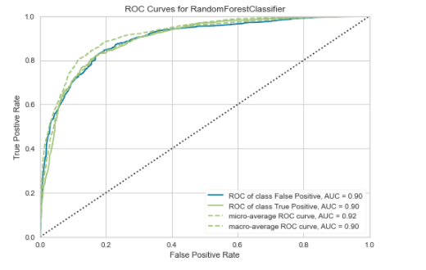
EDA
A receiver operating characteristic (ROC) curve is a graph representing the performance of a classification model for all classification thresholds. This curve plots the rate of true positives versus the rate of false positives.

Slide 19
EDA
A receiver operating characteristic (ROC) curve is a graph representing the performance of a classification model for all classification thresholds. This curve plots the rate of true positives versus the rate of false positives.

